Slide 1

DEFECTS IN CRYSTALS
Point defects
Line defects
Surface Imperfections

Slide 2
PROPERTIES
Structure sensitive
Structure Insensitive
E.g. Yield stress, Fracture toughness
E.g. Density, elastic modulus

Slide 3
CLASSIFICATION OF DEFECTS BASED ON DIMENSIONALITY
0D
(Point defects)
1D
(Line defects)
2D
(Surface / Interface)
3D
(Volume defects)
Surface
Twins
Vacancy
Dislocation
Interphase
boundary
Precipitate
Impurity
Disclination
Dispiration
Faulted
region
Frenkel
defect
Grain
boundary
Twin
boundary
Voids /
Cracks
Schottky
defect
Stacking
faults
Thermal
vibration
Anti-phase
boundaries

Slide 4
SYMMETRY ASSOCIATED DEFECTS
Translation
Rotation
Screw
Atomic
Level
Dislocation
Disclination
Dispiration
SYMMETRY ASSOCIATED DEFECTS
Mirror
Rotation
Inversion
Twins
Multi-atom

Slide 5
Based on
symmetry
breaking
DEFECTS
Topological
Non-topological
Hence association
with symmetry

Slide 6
Based on
origin
DEFECTS
Random
Structural
Vacancies, dislocations, interface ledges…
Based on
position
DEFECTS
Random
Ordered

Slide 7
THE ENTITY IN QUESTION
GEOMETRICAL
PHYSICAL
E.g. atoms, clusters etc.
E.g. spin, magnetic moment

Slide 8
THE OPERATION DEFINING A DEFECT CANNOT BE A SYMMETRY OPERATION OF THE CRYSTAL
A DEFECT “ASSOCIATED” WITH A SYMMETRY OPERATION OF THE CRYSTAL
➢ TOPOLOGICAL DEFECT

Slide 9
Vacancy
Non-ionic
crystals
Interstitial
Impurity
Substitutional
0D
(Point defects)
Frenkel defect
Ionic
crystals
Other ~
Schottky defect
Imperfect point-like regions in the crystal about the size of 1-2 atomic
diameters

Slide 10
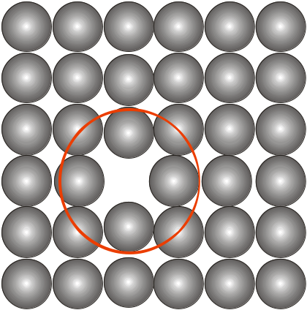
Vacancy
Missing atom from an atomic site
Atoms around the vacancy displaced
Tensile stress field produced in the vicinity
Tensile Stress
Fields ?

Slide 11
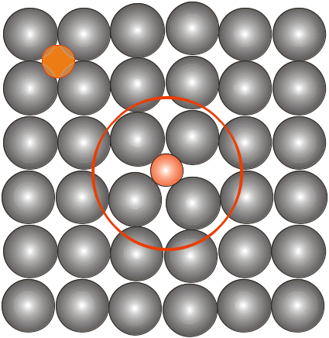
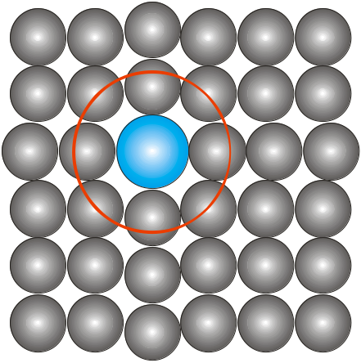
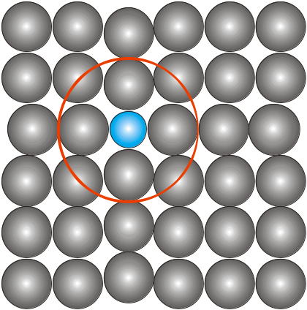
Relative
size
Interstitial
Compressive
Stress
Fields
Impurity
Substitutional
Compressive stress fields
SUBSTITUTIONAL IMPURITY
• Foreign atom replacing the parent atom in the crystal
• E.g. Cu sitting in the lattice site of FCC-Ni
INTERSTITIAL IMPURITY
• Foreign atom sitting in the void of a crystal
• E.g. C sitting in the octahedral void in HT FCC-Fe
Tensile Stress
Fields

Slide 12
Interstitial C sitting in the octahedral void in HT FCC-Fe
r_{Octahedral void} / r_{FCC atom} = 0.414
r_{Fe-FCC} = 1.29 Å ⇒ r_{Octahedral void} = 0.414 x 1.29 = 0.53 Å
r_{C} = 0.71 Å
⇒ Compressive strains around the C atom
Solubility limited to 2 wt% (9.3 at%)
Interstitial C sitting in the octahedral void in LT BCC-Fe
r_{Tetrahedral void} / r_{BCC atom} = 0.29 • r_{C} = 0.71 Å
r_{Fe-BCC} = 1.258 Å ⇒ r_{Tetrahedral void} = 0.29 x 1.258 = 0.364 Å
► But C sits in smaller octahedral void- displaces fewer atoms
⇒ Severe compressive strains around the C atom
Solubility limited to 0.008 wt% (0.037 at%)

Slide 13
ENTHALPY OF FORMATION OF VACANCIES
Formation of a vacancy leads to missing bonds and distortion of the
lattice
The potential energy (Enthalpy) of the system increases
Work required for the formaion of a point defect →
Enthalpy of formation (ΔH_{f}) [kJ/mol or eV / defect]
Though it costs energy to form a vacancy its formation leads to
increase in configurational entropy
⇒ above zero Kelvin there is an equilibrium number of vacancies
Crystal | Kr | Cd | Pb | Zn | Mg | Al | Ag | Cu | Ni
kJ / mol | 7.7 | 38 | 48 | 49 | 56 | 68 | 106 | 120 | 168
eV / vacancy | 0.08 | 0.39 | 0.5 | 0.51 | 0.58 | 0.70 | 1.1 | 1.24 | 1.74

Slide 14
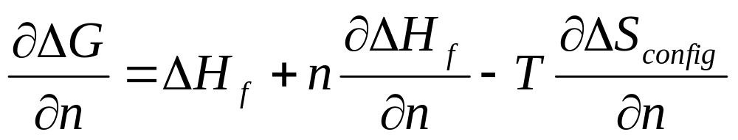
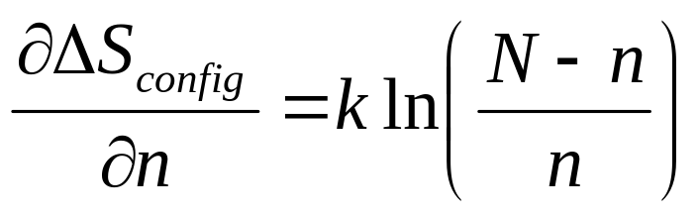
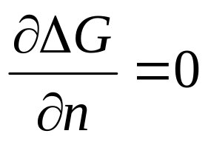
Let n be the number of vacancies, N the number of sites in the lattice
Assume that concentration of vacancies is small i.e. n/N << 1
⇒ the interaction between vacancies can be ignored
⇒ ΔH_{formation} (n vacancies) = n . ΔH_{formation} (1 vacancy)
Let ΔH_{f} be the enthalpy of formation of 1 mole of vacancies
ΔG = ΔH − T ΔS
ΔS = ΔS_{thermal} + ΔS_{configurational}
ΔG (putting n vacancies) = nΔH_{f} − T ΔS_{config}
Larger contribution
zero
For minimum

Slide 15
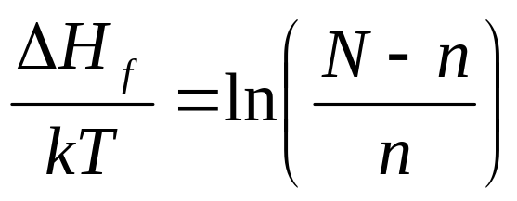
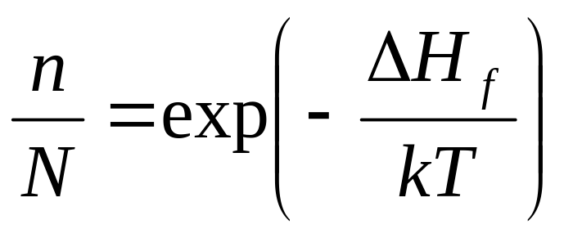
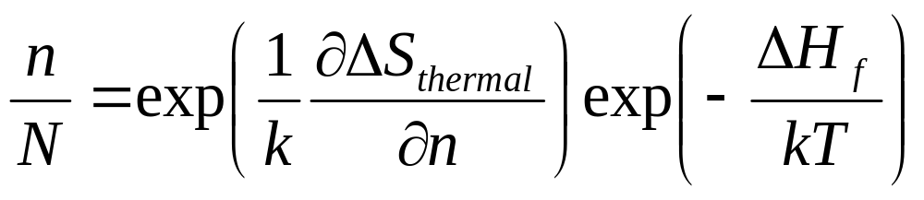
⇒
Assuming n << N
Considering only configurational entropy
User R instead of k if ΔH_{f} is in J/mole
?
Using
ΔS = ΔS_{thermal} + ΔS_{configurational}
Independent of temperature, value of ~3

Slide 16
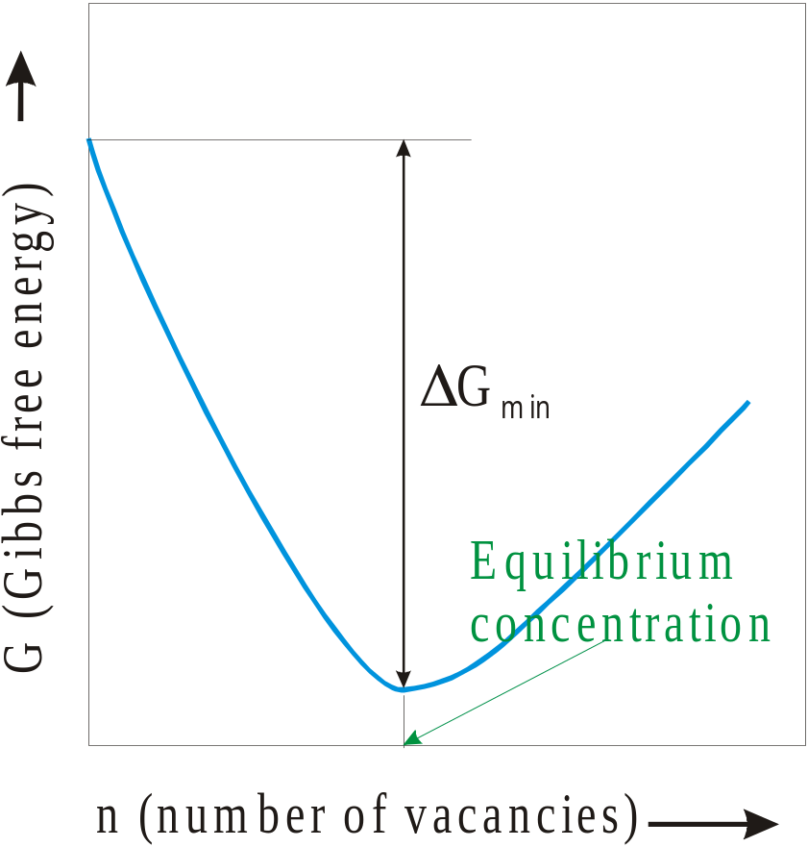
G (perfect crystal)
T (ºC) | n/N
500 | 1 x 10⁻¹⁰
1000 | 1 x 10⁻⁵
1500 | 5 x 10⁻⁴
2000 | 3 x 10⁻³
ΔH_{f} = 1 eV/vacancy = 0.16 x 10⁻¹⁸ J/vacancy
At a given T
Certain equilibrium number of vacancies are preferred at T > 0K

Slide 17
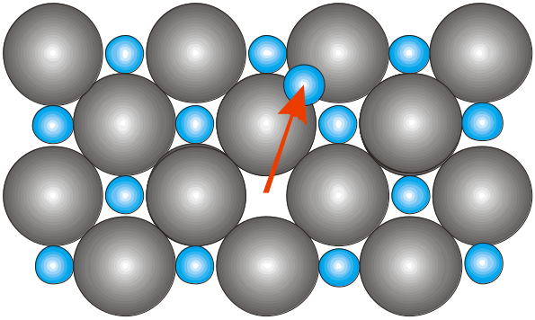
Ionic Crystals
Overall electrical neutrality has to be maintained
Frenkel defect
Cation (being smaller get displaced to interstitial voids
E.g. AgI, CaF₂

Slide 18
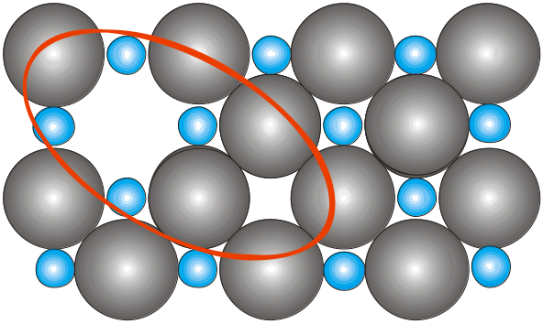
Schottky defect
Pair of anion and cation vacancies
E.g. Alkali halides

Slide 19
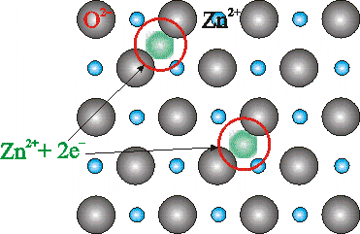
Other defects due to charge balance
If Cd²⁺ replaces Na⁺ → one cation vacancy is created
Defects due to off stiochiometry
ZnO heated in Zn vapour → Zn_{y}O (y >1)
The excess cations occupy interstitial voids
The electrons (2e⁻) released stay associated to the interstitial cation

Slide 20
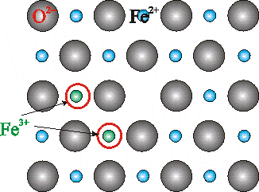
FeO heated in oxygen atmosphere → Fe_{x}O (x <1)
Vacant cation sites are present
Charge is compensated by conversion of ferrous to ferric ion:
Fe²⁺ → Fe³⁺ + e⁻
For every vacancy (of Fe cation) two ferrous ions are converted to
ferric ions → provides the 2 electrons required by excess oxygen

